Slide 1

NYC Transportation Analysis
GUC
Abdullah Kamal
Ahmed Abdullah
Adham El Sharkawy
Ajeeb El Ameen
Osama El Naggar

Slide 2
Table of contents
01
02
03
04
Objectives
05
Analysis & Insights
Data Overview
06
Fare Prediction
Process & Pipeline
Challenges & Processing
07
Conclusion
08
Future Direction

Slide 3

Objectives
The project is designed to analyze NYC public transportation data with the goal of understanding how accessible different neighborhoods are.
It also explores how well-connected emerging areas are.
the project aims to support more efficient mobility planning.
this helps both long-time residents and newcomers navigate the city more easily.

Slide 4

How it Started
Bus: 13 CSVs/Parquets
Taxi: 49 CSVs/Parquets
Subway: 365 CSVs/Parquets
Bus lane: 1 CSV
Merged datasets
Bus : 8 CSVs/Parquets
Taxi: 3 CSVs/Parquets
Subway: 1 Parquet
Bus lane: 1 CSV

Slide 5
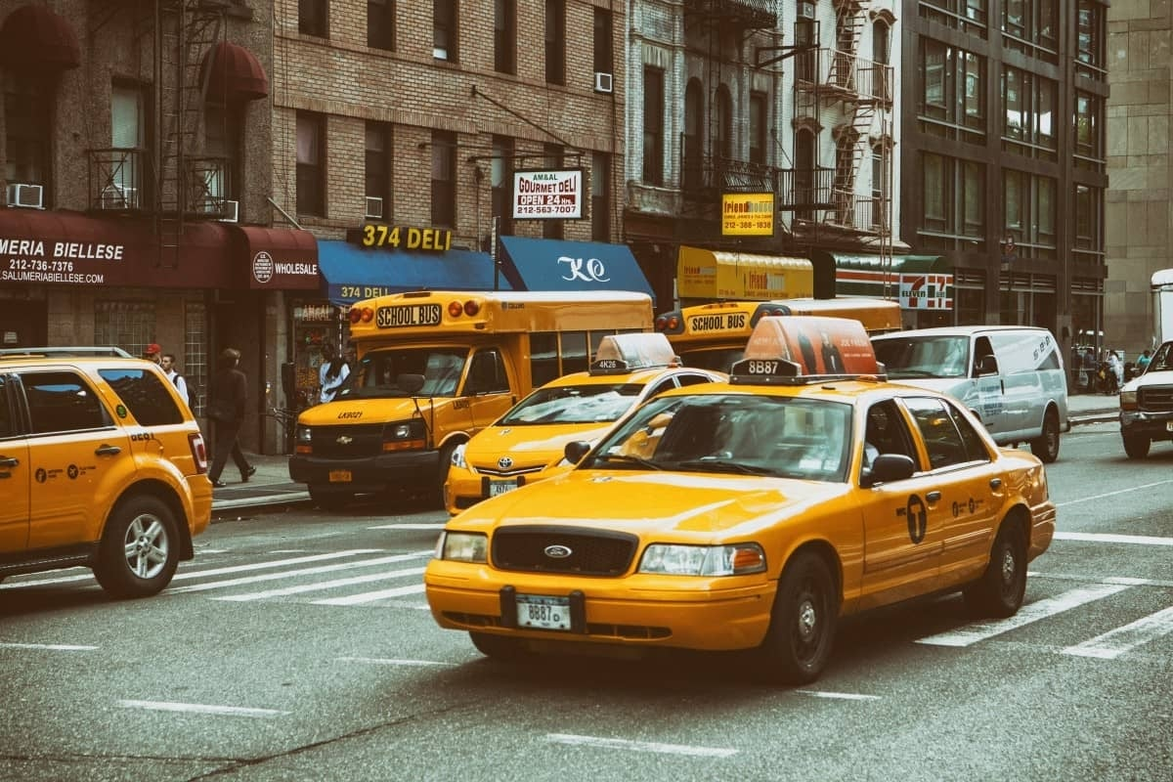
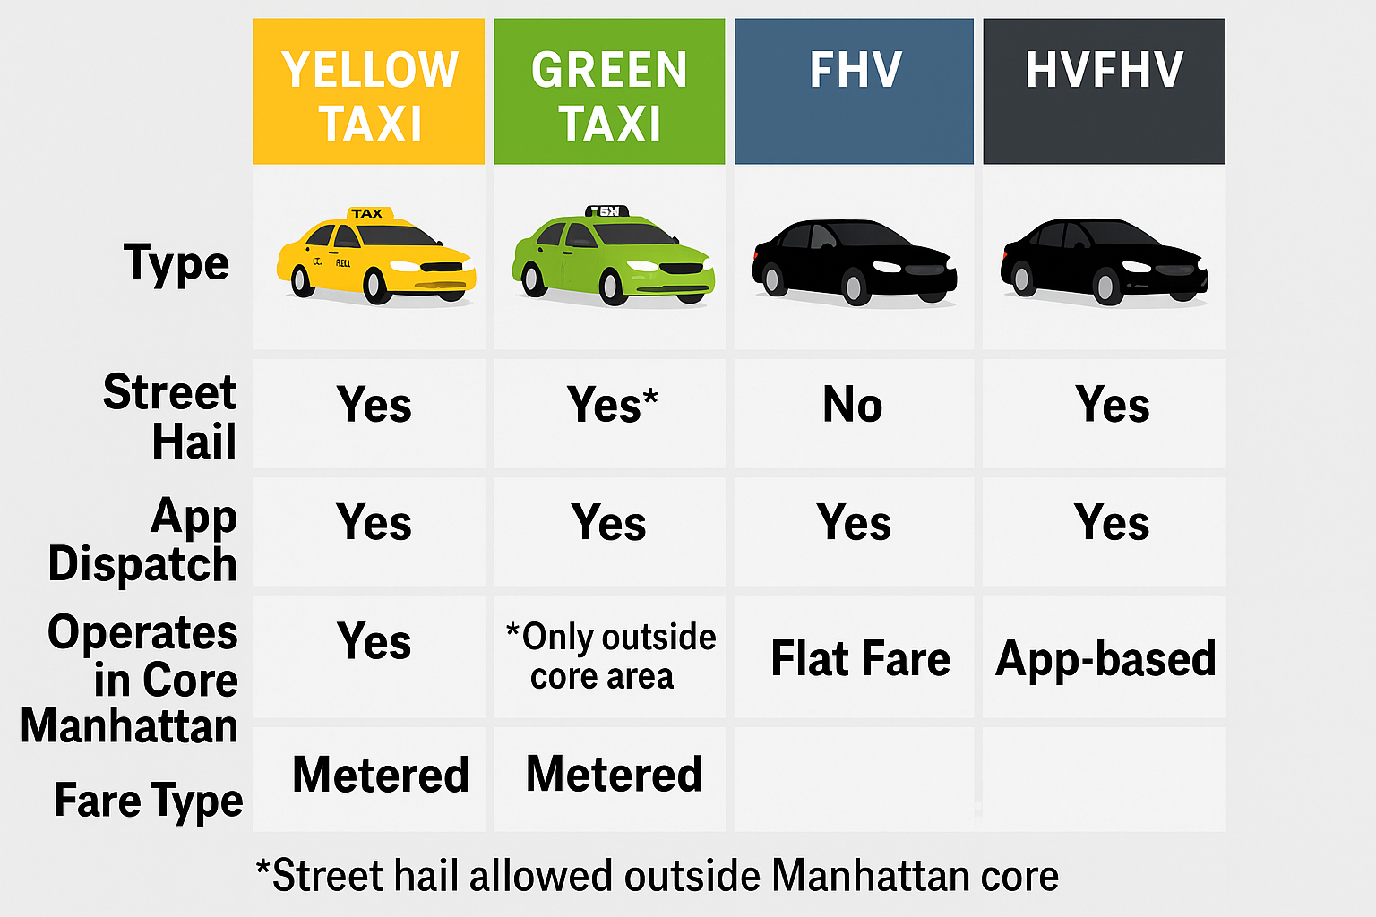
Taxi data Overview
Trip-level insights: When, where, and how people travel across the city.
Service comparisons: Between yellow taxis, green taxis, high-volume FHVs (app-based services like Uber and Lyft).
Fare and payment details: Including distance, duration and fare breakdowns.
Geographic coverage: Pickup and drop-off zones across all boroughs and airports.

Slide 6
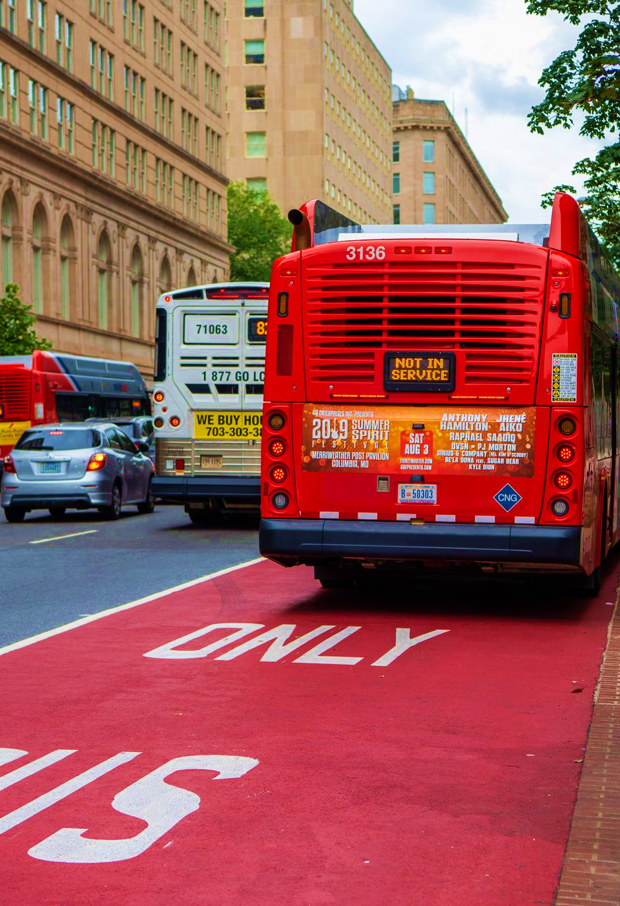
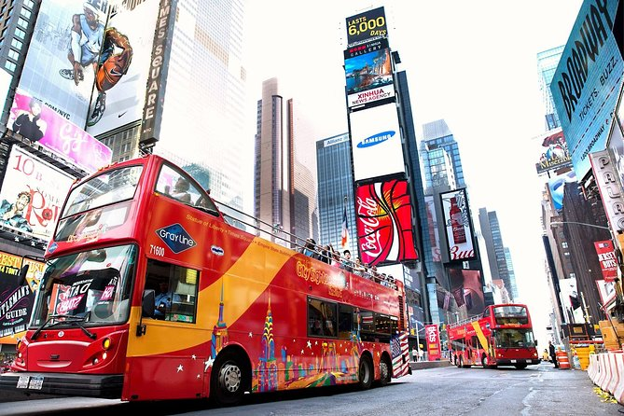
Bus & Bus lane data Overview
Operational Performance: Service time, wait times and speed.
Customer Experience: Journey times, ridership patterns, and accessibility usage.
Temporal & Spatial Coverage: Data spans hourly to quarterly, and from stop-level to systemwide.
Geographic details of each bus lane segment, including street name, direction, and borough.
Operational characteristics such as lane type, width, hours and working days.
Historical data on when lanes were implemented or modified.

Slide 7
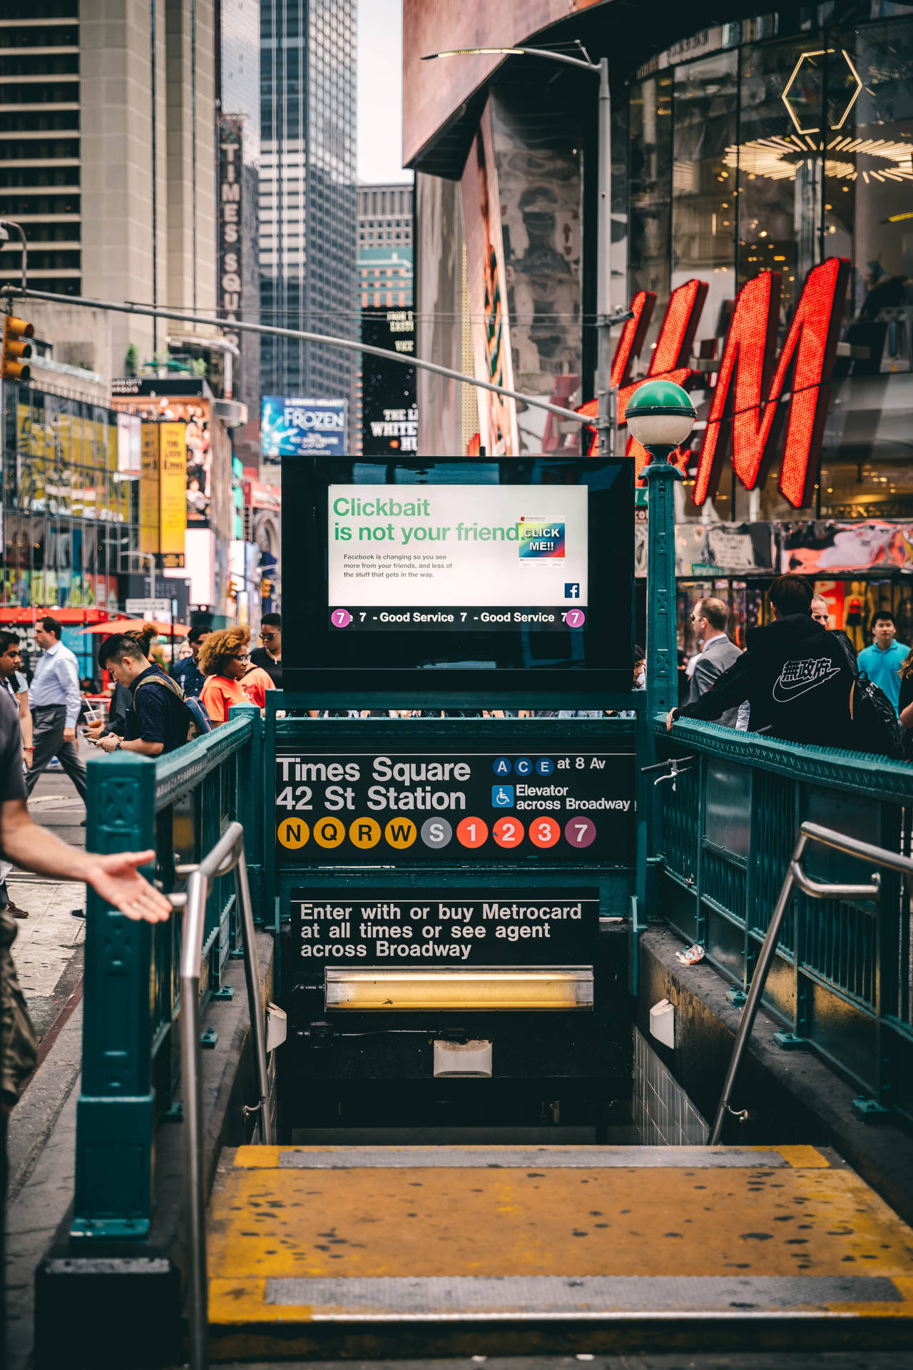
Subway data Overview
Trip-Level Information: Captures key metadata for each subway trip, including route, direction and service schedule.
Detailed Stop Timing: Records precise arrival and departure times at each station
Integrated View of System Behavior providing a full picture of how the subway system operates across time and space and borough

Slide 8
Project Process

Slide 9
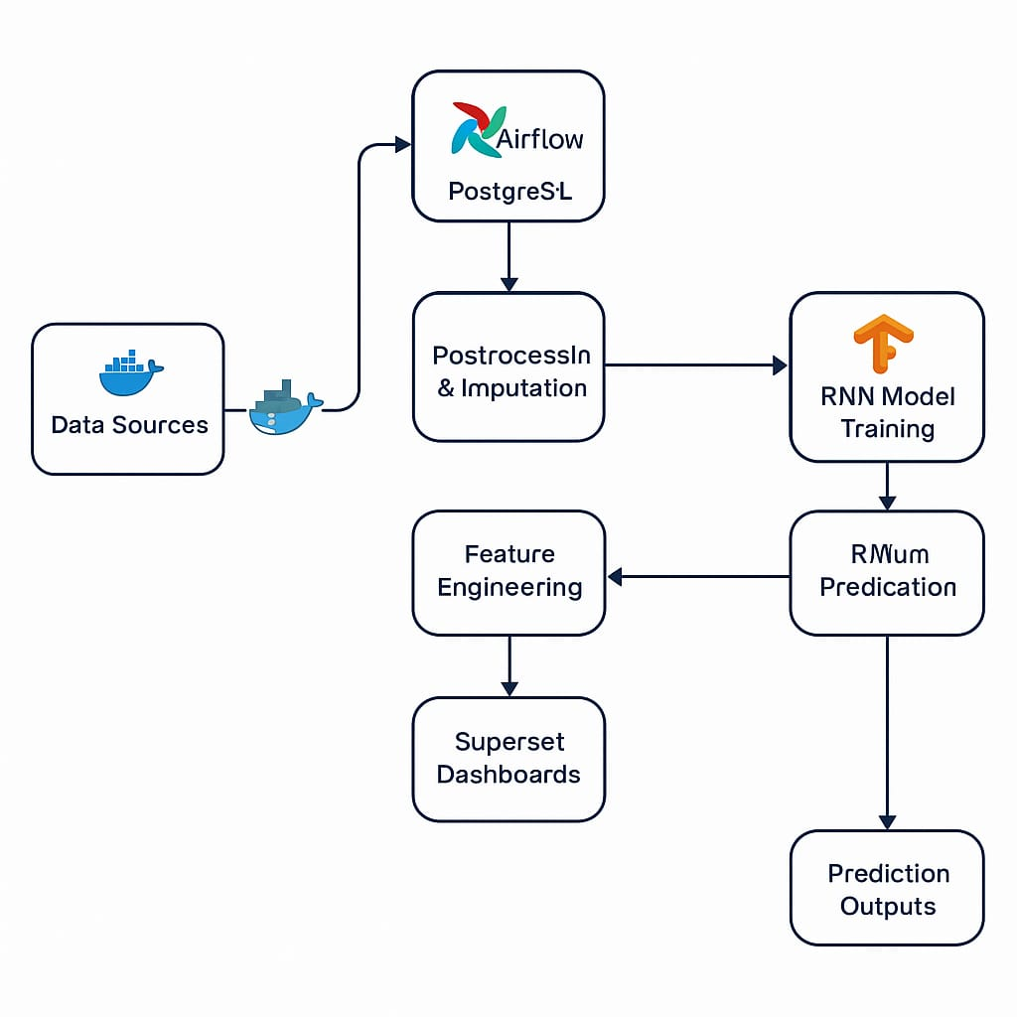









NYC Transportation Analysis Process
Fetched Multiple Sources via ETL

Slide 10
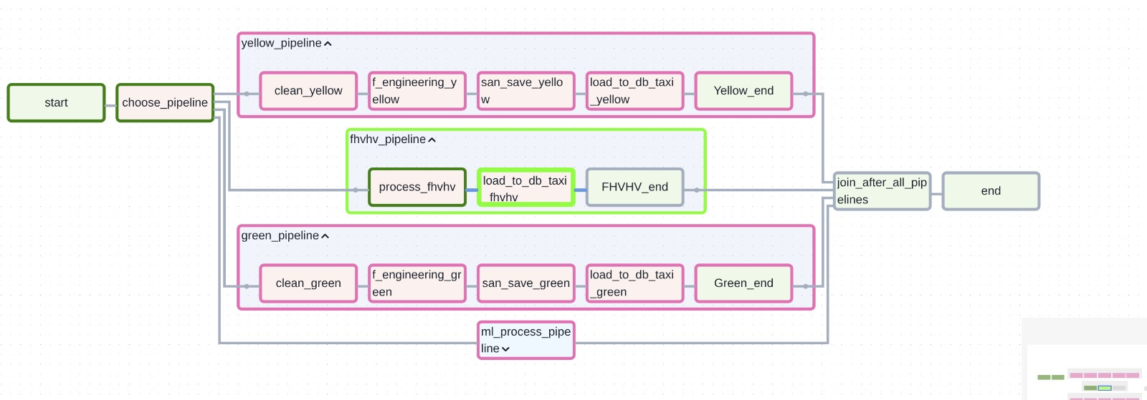
Project Pipeline
Project data pipelines, where we applied grouping and chaining to optimize memory usage through partitioning and chunking, supported by underlying Python code.

Slide 11


Key Challenges

Slide 12
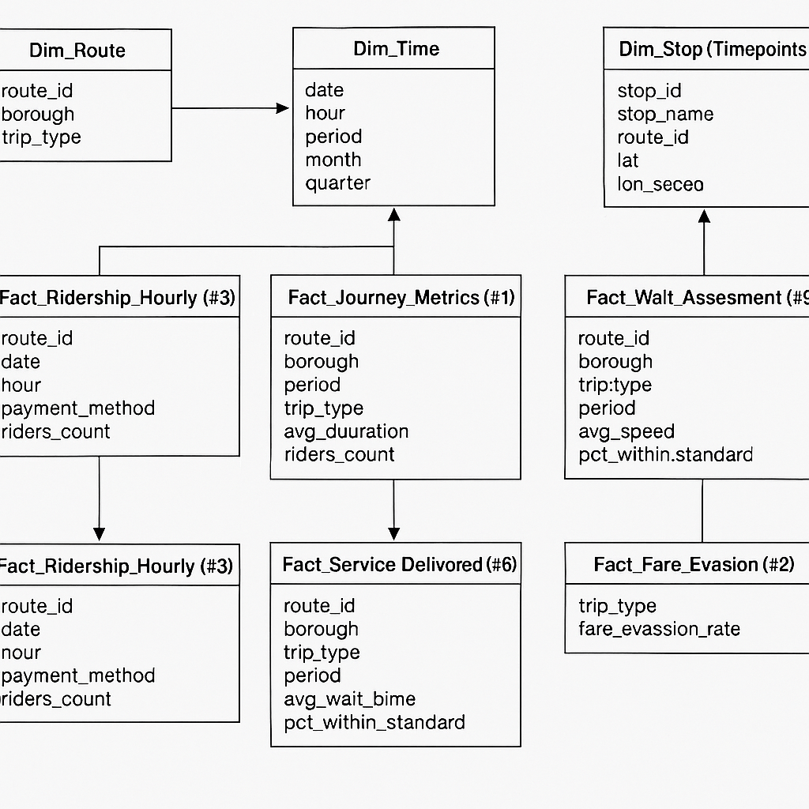
Challenges
Large - scale File Merging & Memory Management
First, we sourced all data from authorized and official web platforms.
One major challenge was handling massive datasets (70 million records). This raised serious concerns around memory management and processing performance.
To overcome this, we used stratified sampling to preserve temporal patterns and adopted chunked processing to prevent memory overload.
Different time stamps
A key challenge was integrating datasets collected with different time stamps for bus datasets (e.g., monthly, daily, hourly).
To enable consistent analysis, we standardized all data to a unified monthly time stamp.
Structure Challenge
the datasets lacked a predefined structure for integration.
We tackled this by first defining our analytical objectives, selecting eight key datasets, and designing a star schema to guide the merging and ensure consistent relationships between dimensions and facts

Slide 13
Pre-processing

Slide 14
Data Cleaning
Preprocessing phase, where we implemented both standard and advanced techniques
Data cleaning, we followed a two-pronged approach:
First, cross-referencing with MTA sources for data validation;
Second, we applied multivariate and hyper-imputation methods to fill missing values effectively.
Feature Engineering
Feature engineering was a core part of our workflow. We extracted time-based features such as hour, day, and month, and derived performance metrics including average trip speed, median speed per borough, and a congestion matrix.
These engineered features were not just technical enhancements — they were essential for uncovering real insights into urban transportation dynamics in NYC.

Slide 15
Bus & Bus Lanes Analysis

Slide 16
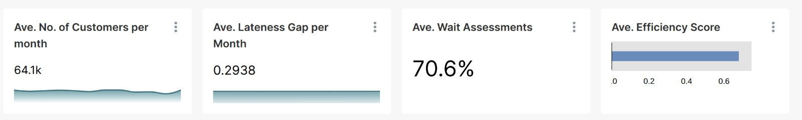
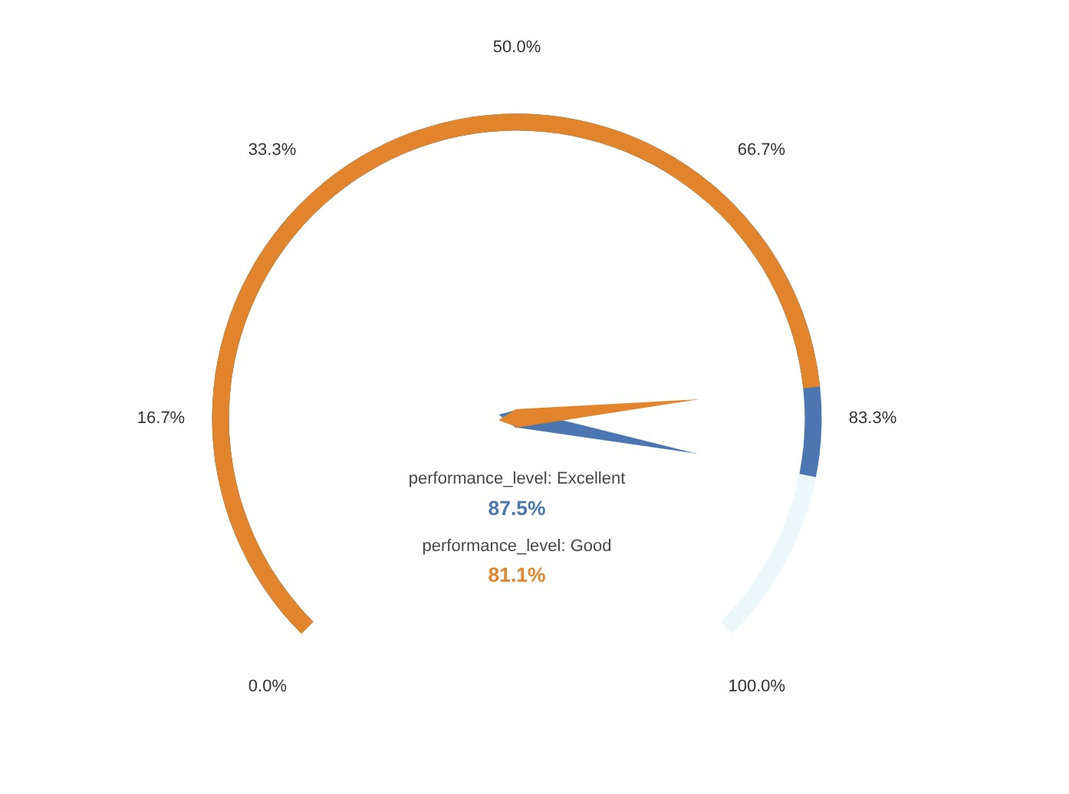
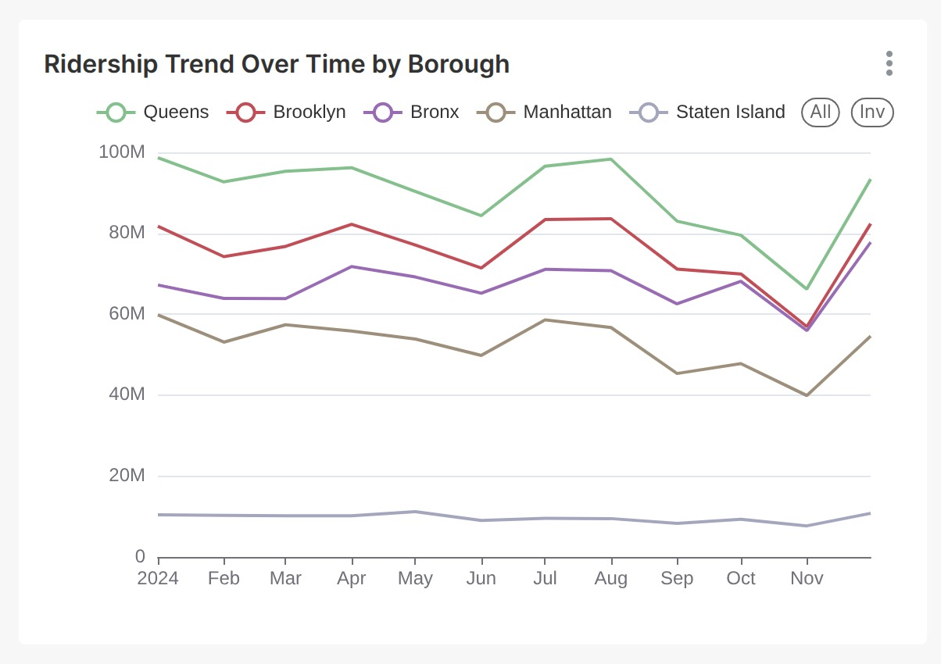
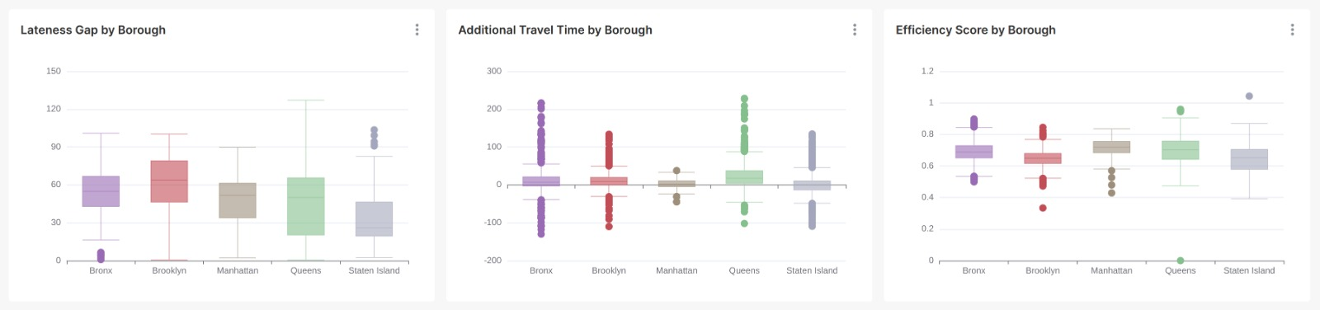
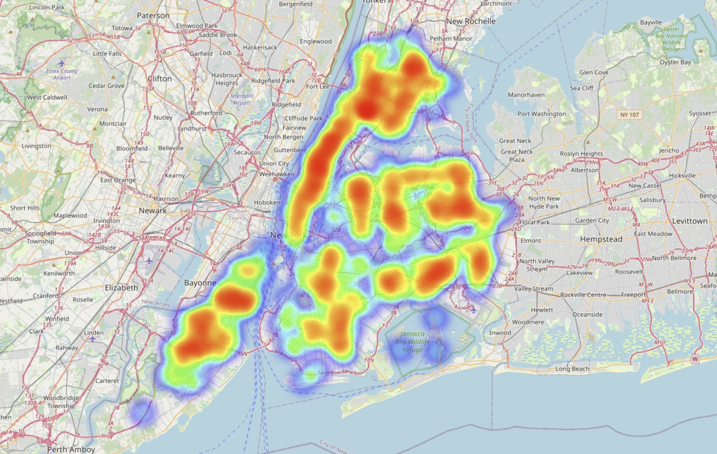
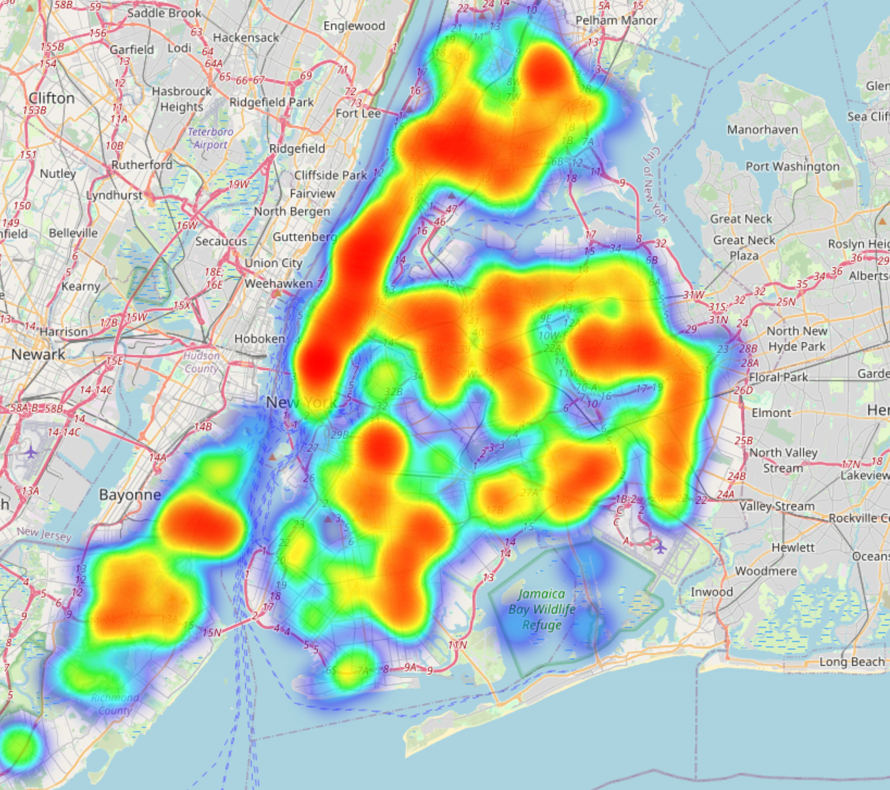
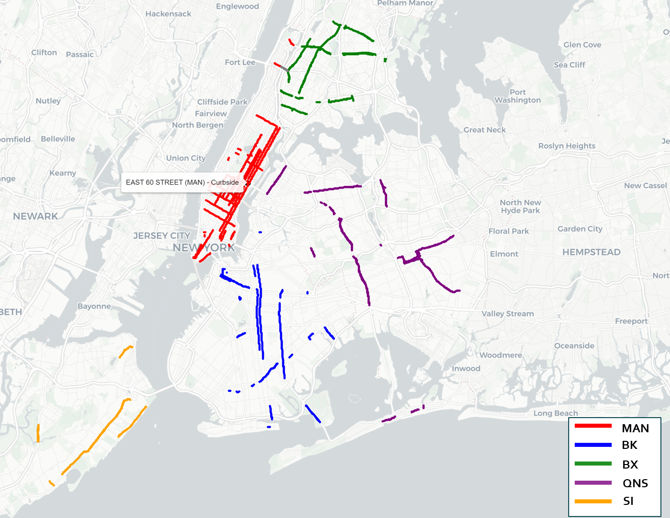
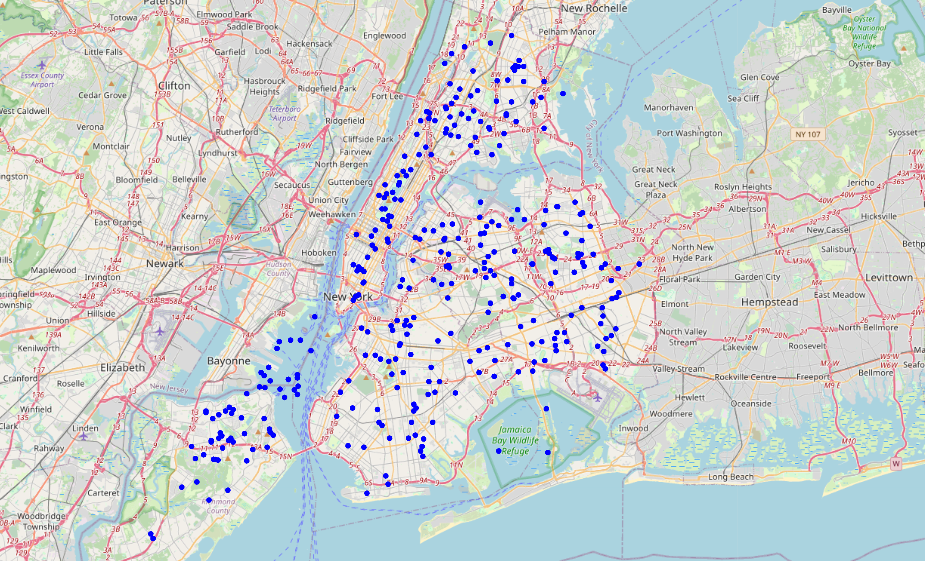
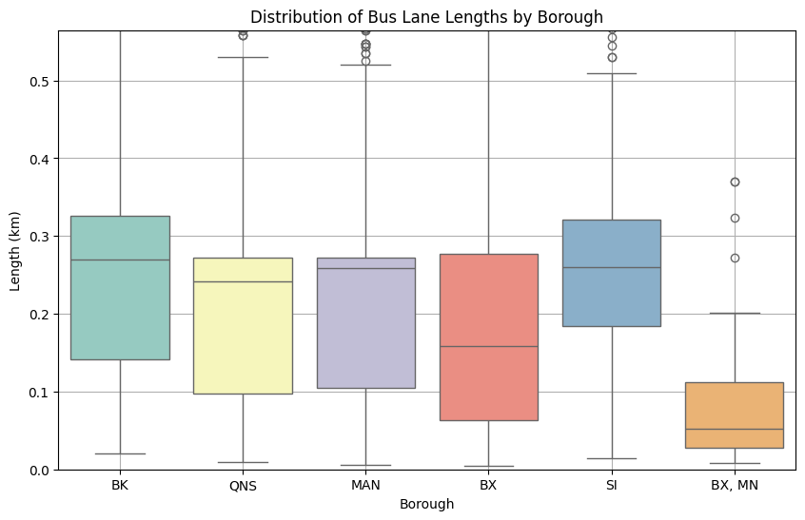
KPIs.
Efficiency index by Efficiency level
Ridership Density per Trip
Performance index heatmap.
Bus lanes Dist.
Bus Stops Dist.

Slide 17
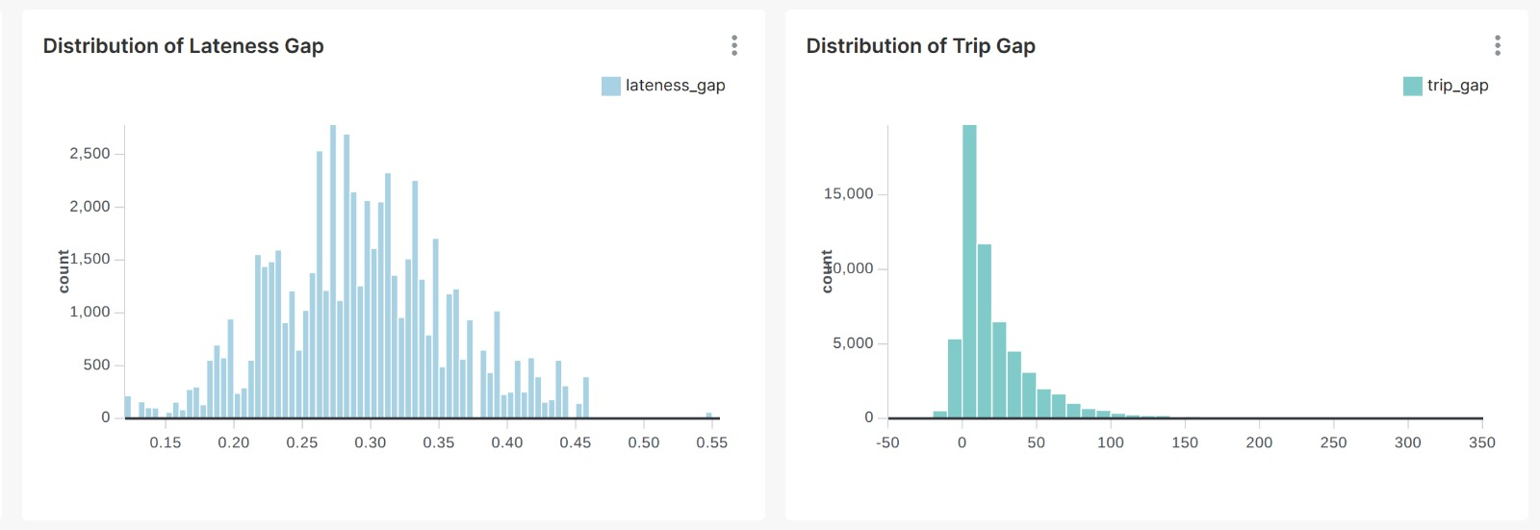
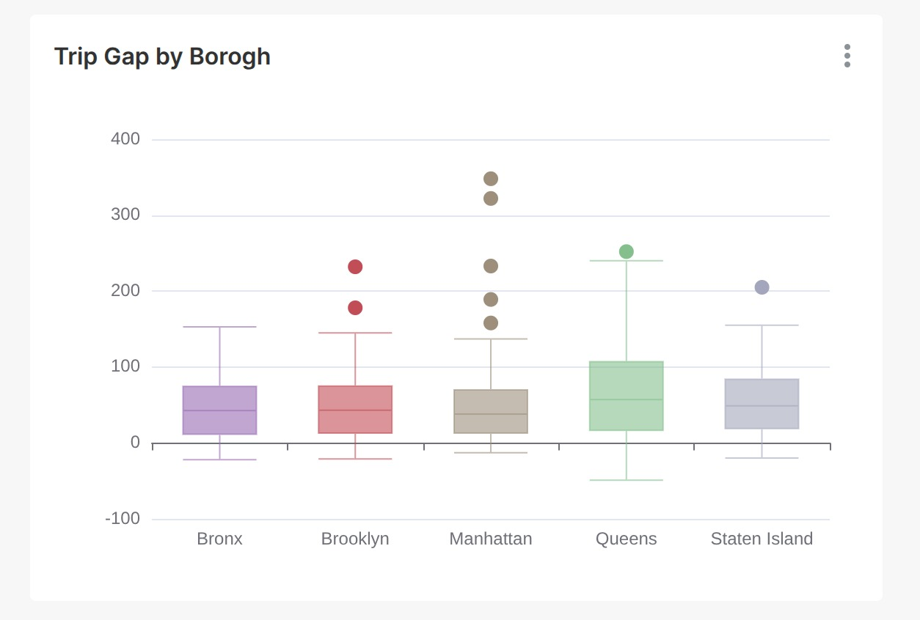
Key insights
Boroughs like Staten Island and Bronx show higher trip gaps and under-service flags.
Routes with high additional travel time often correspond to lower performance index values.
Journey time & travel time heatmaps highlight congestion areas.
Cross-correlation shows temporal links between ridership and customer experience.
Spatially, ridership was densest in Manhattan & Queens, while Staten Island showed significantly lower activity.
Bus stop stations were well-distributed, offering good city-wide coverage.
Performance metrics like trip gap and lateness gap were generally low, suggesting high reliability.
Top performing route: QM31 while Lowest performing route: B94
Notes:
Avg Trips per Month: 291,878,761-
Borough with Highest Total Trips: Queens (1,061,440,435)-
Top Performing Route (by Index): QM31-
Lowest Performing Route (by Index): B94-
Avg. Journey Time Performance: 0.68-
🕒 Max Trip Gap: 348.00-
🕒 Max Lateness Gap: 0.55
📉 Avg. Efficiency Score: 0.68

Slide 18
Taxi Analysis

Slide 19
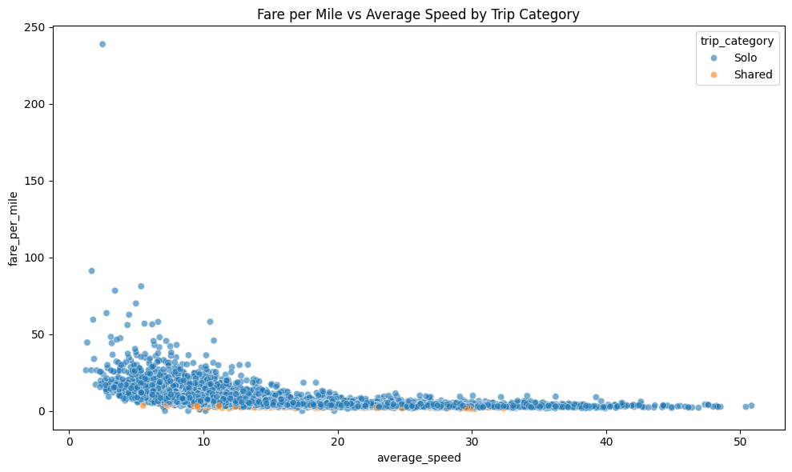
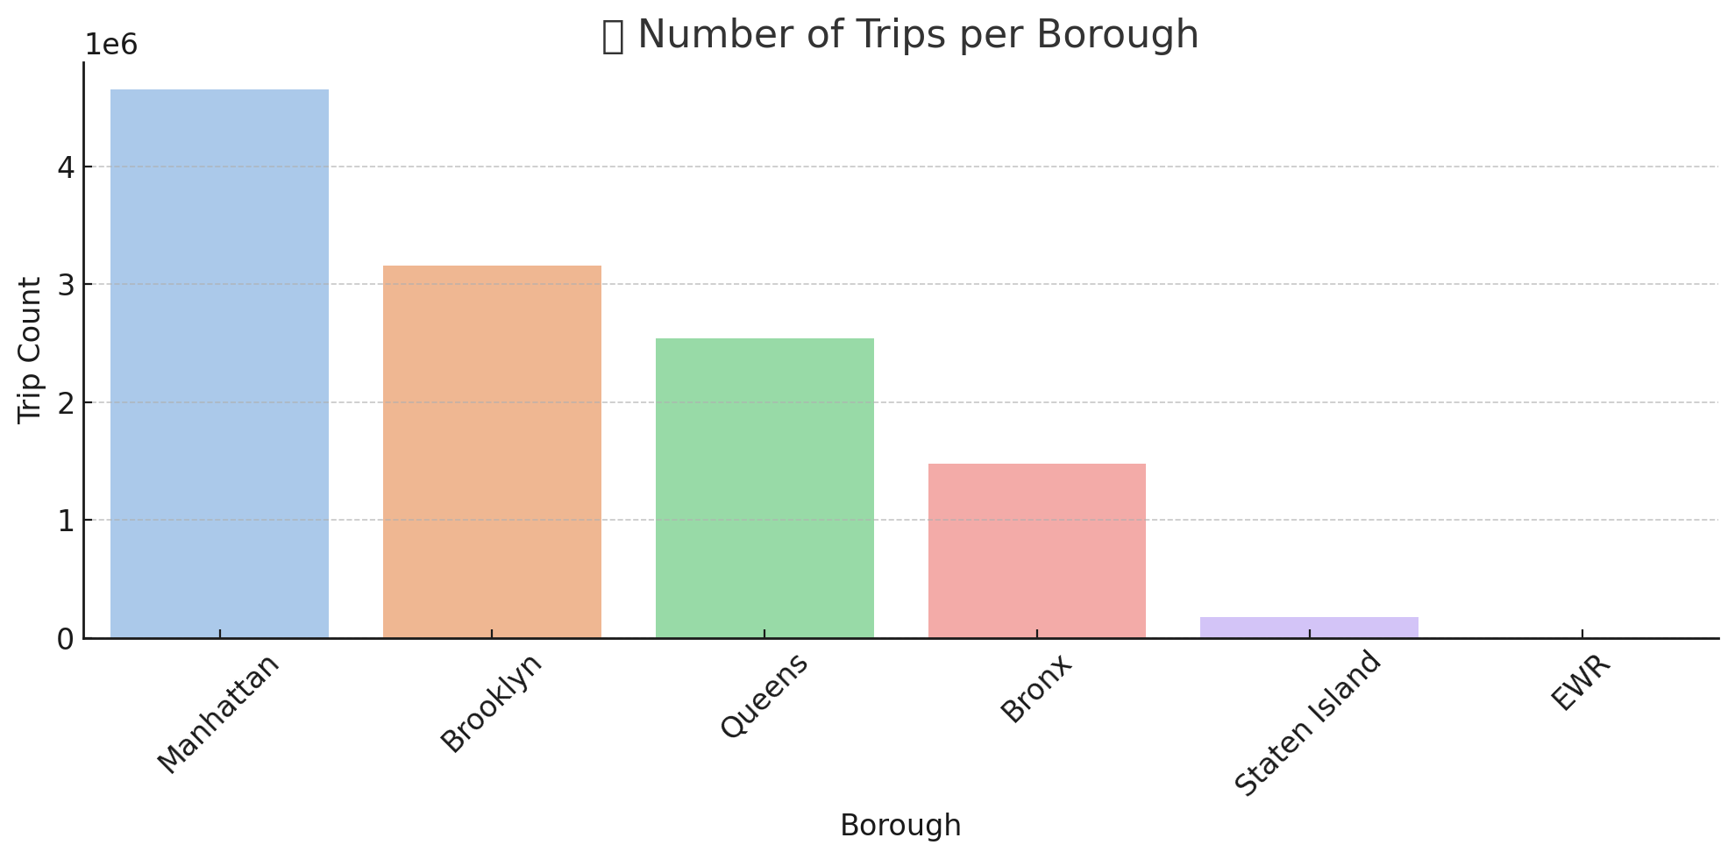
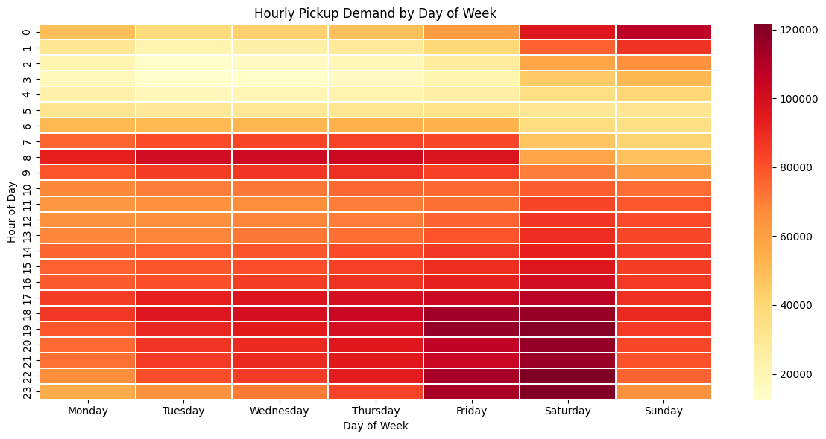
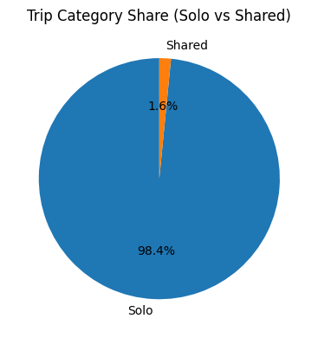
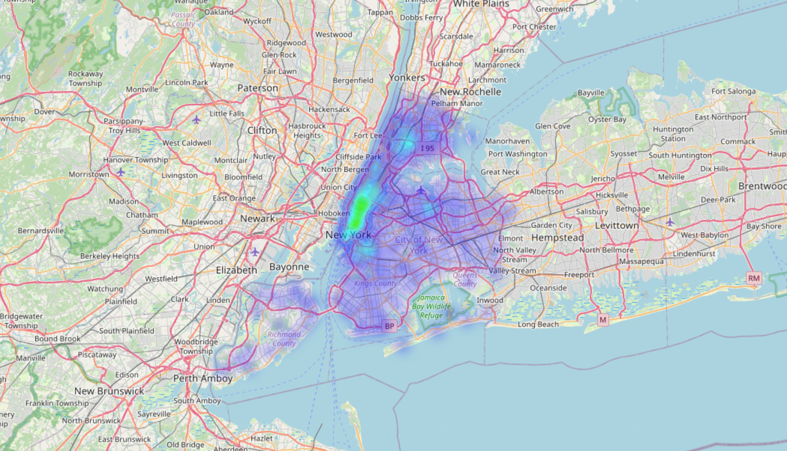
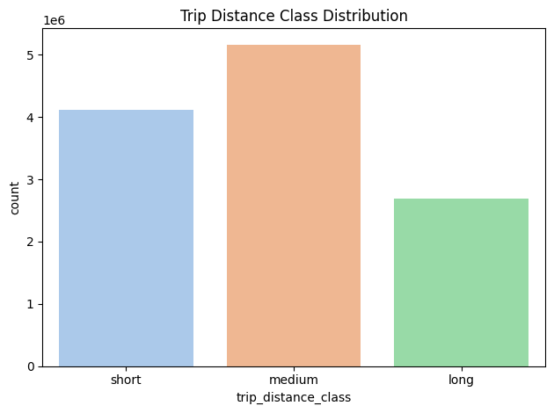
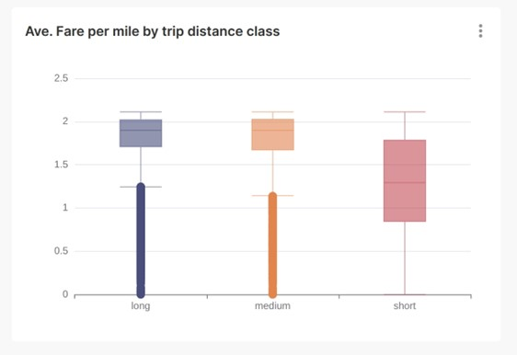
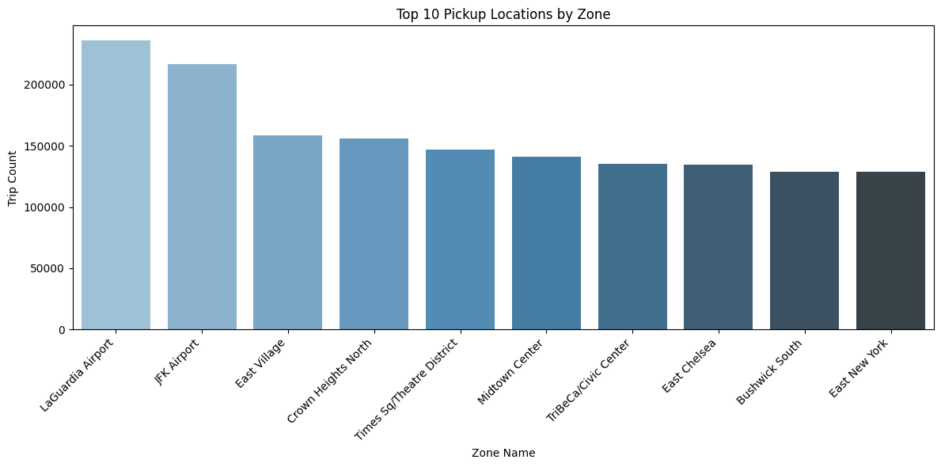
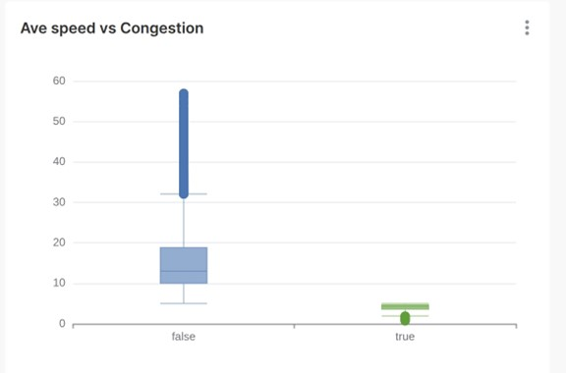
KPIs.
7.4 $
Avg fare per mile
20 min
Avg, trip time
5 mile
Avg, trip distance
1500 $
Max Total Fare
470 mile
Max Trip Distance
FHVHV
Pickup Heat map

Slide 20
Key insights
Trip overview: We analyzed nearly 12 million trips across 2024.
About 98% were solo trips, and short to medium distances made up 80% of the sample.
In terms of market share, Uber accounted for around 75%, and Lyft 25%, of FHVHV trips.
Fare analysis showed that average fare per mile was highest for short trips, especially under 2 miles — largely due to base fare thresholds and congestion fees.
Fare insights included: (Median base fare: ~$19.60 - Average total fare: ~$31.60 - Maximum recorded fare: over $1,400)
Distance and duration metrics: (Median trip: ~3 miles - Average duration: ~20 minutes)
Average speed: ~13.6 mph — reflecting typical NYC congestion"
Hourly pickup : demand peaked during rush hours (7–8 AM and 4–6 PM), and surged again late at night on weekends.
highest demand : Manhattan and Brooklyn saw the highest demand in both pickups and drop-offs.
Lower average speeds in these zones also aligned with higher congestion and trip density."

Slide 21
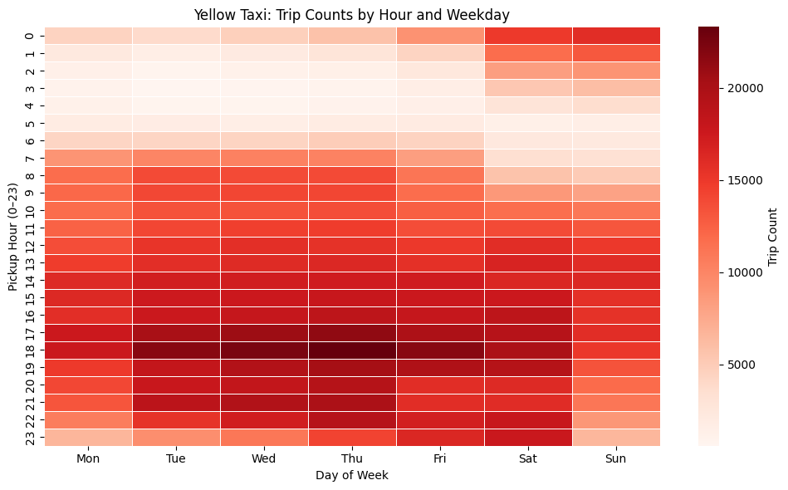
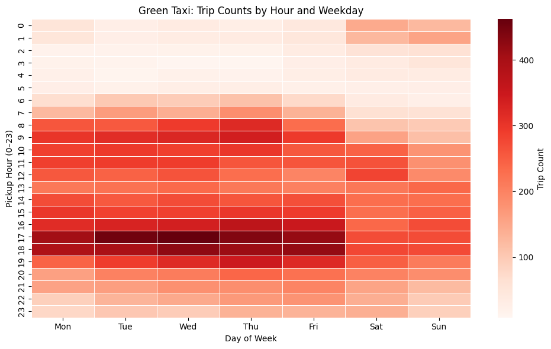
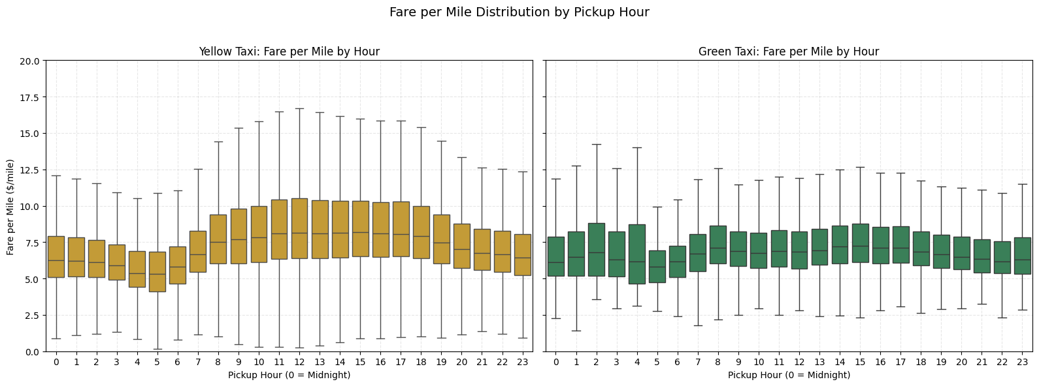
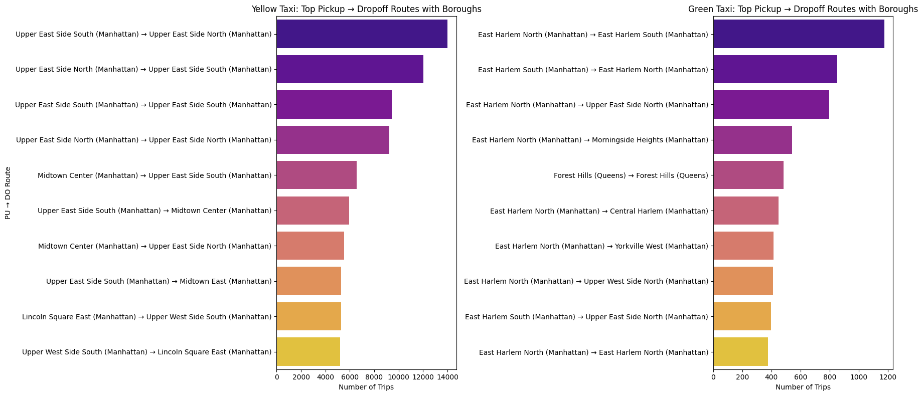
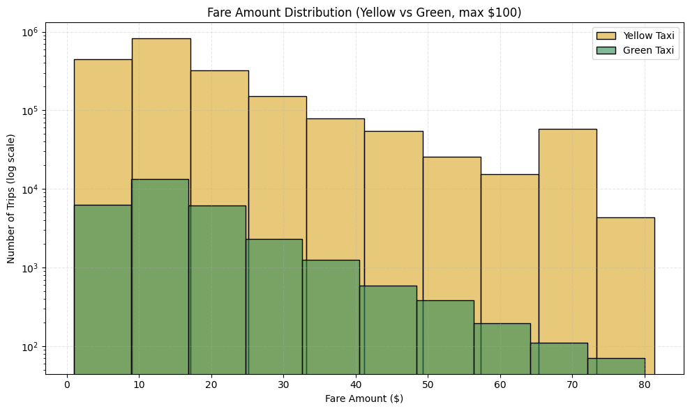
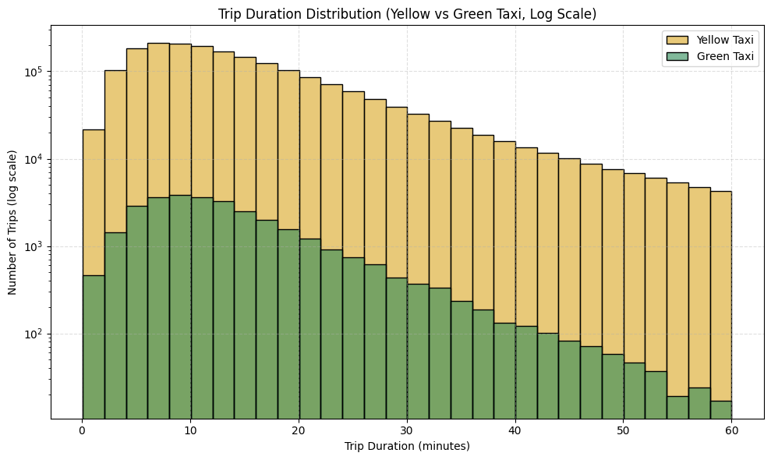
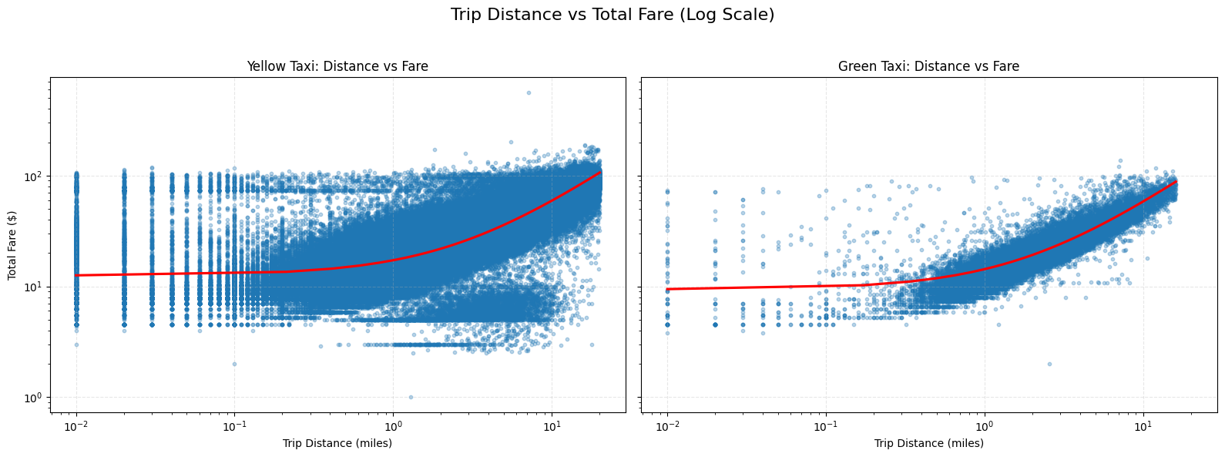
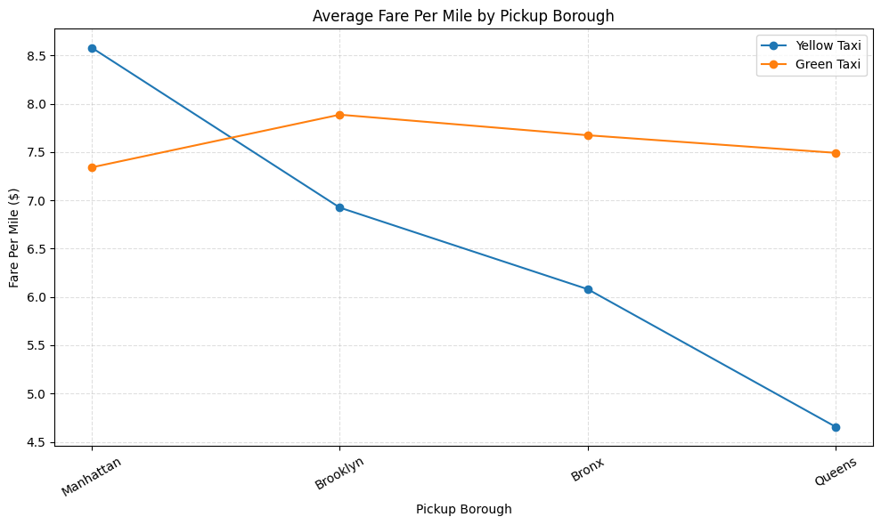
12 $
Avg, fare per mile
16 min
Avg, trip time
3 mile
Avg, trip distance
560 $
Max Total Fare
20 mile
Max Trip Distance
KPIs.
12 $
Avg, fare per mile
14 min
Avg, trip time
2.5 mile
Avg, trip distance
137 $
Max Total Fare
16 mile
Max Trip Distance

Slide 22
Key insights
Overall, both types showed very similar patterns:
Average fare per mile: around $12, notably higher than FHVHV - Trip duration and distances were also quite aligned
Demand patterns showed typical weekday peaks, especially 8–9 AM and 4–6 PM, with weekend trips increasing in the afternoon and evening."
Spatial analysis revealed concentration in Manhattan and Brooklyn, while Queens and the Bronx had moderate activity.
Fare per mile was highest in Manhattan, reflecting higher congestion and shorter trip distances.
Trip and fare distributions showed that most rides were 1–3 miles, priced between $10–$25.
Congestion analysis indicated that flagged trips averaged 8 mph, while normal rides ranged between 11–14 mph."
In summary:
Both Yellow and Green taxis primarily served short, solo, intra-borough trips,
Exhibited strong weekday patterns,
Displayed fare structures shaped by traffic and urban density.

Slide 23
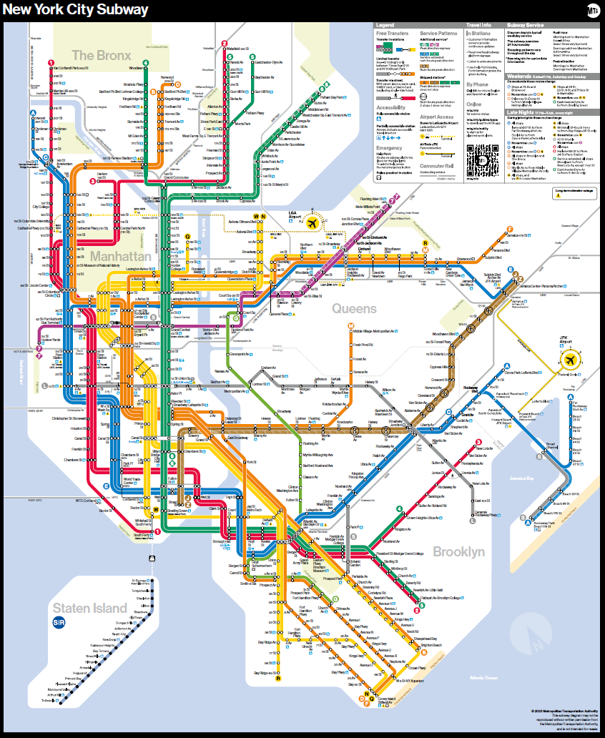
Subway Analysis

Slide 24
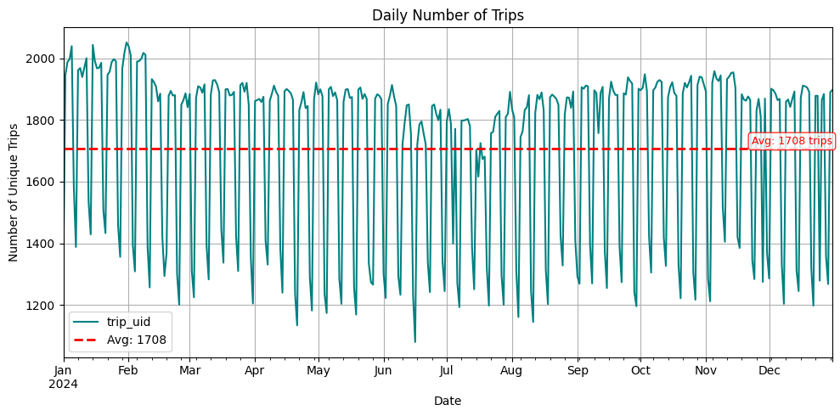
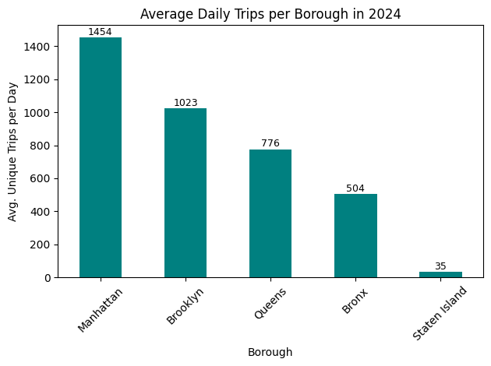
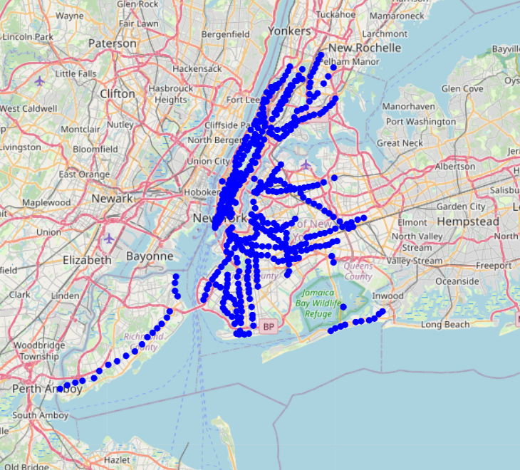
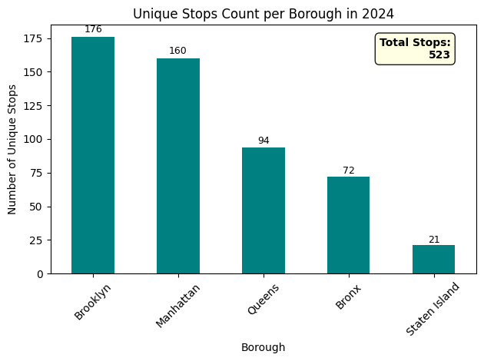
KPIs
Average Daily Trips
1,708 Trips
Total Stations
523
Average Stop Duration
32 Seconds

Slide 25
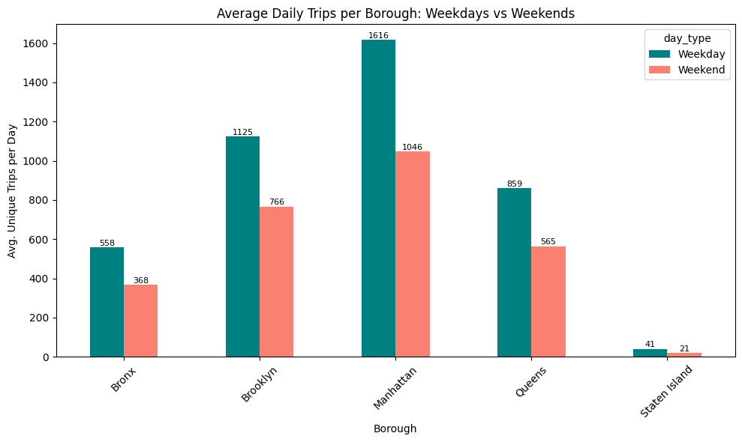
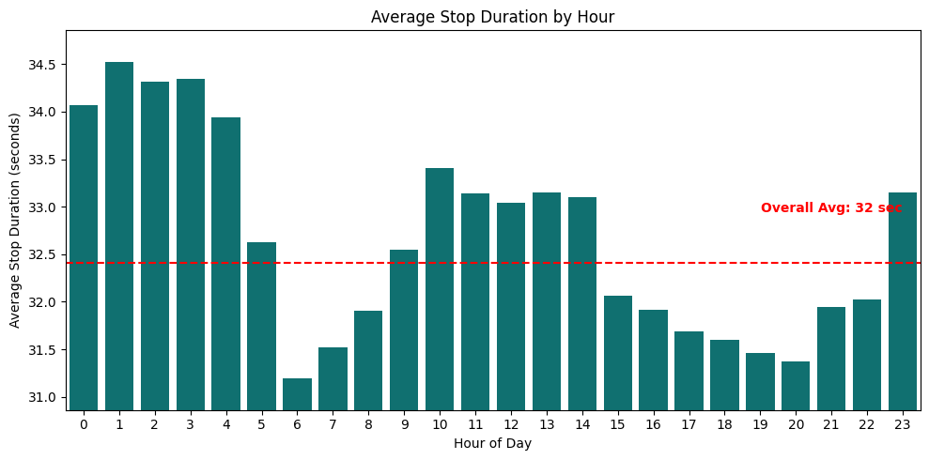
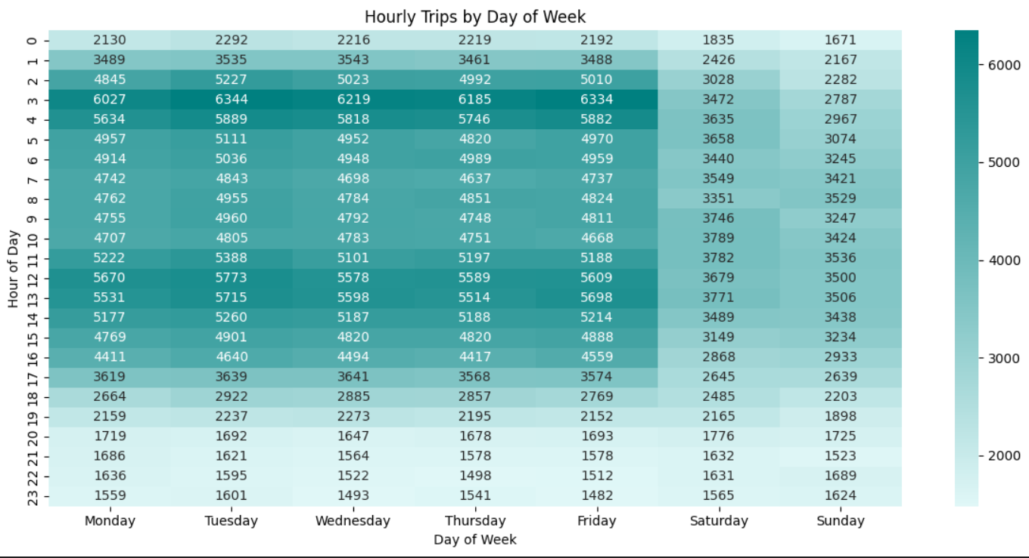
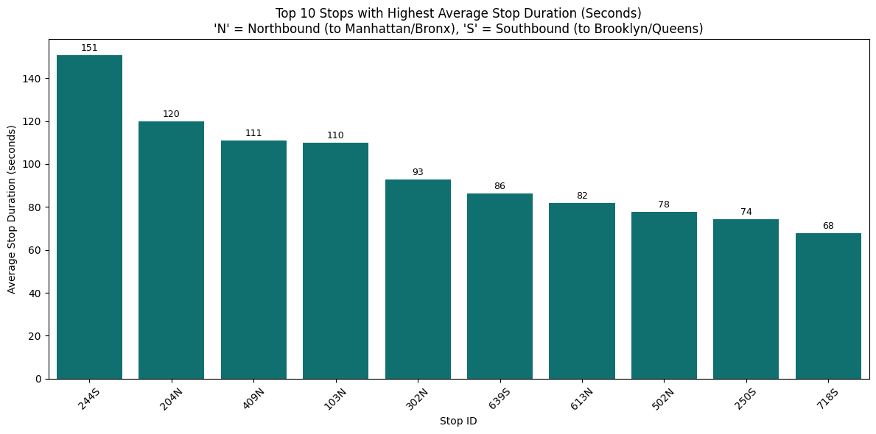

Slide 26
Predicting Taxi fares

Slide 27
Predicting Taxi Fare
This project develops a machine learning model to predict NYC taxi trip fares by leveraging structured trip data and deep learning with embedding layers.
The resulting model demonstrates strong predictive performance, offering practical applications for various stakeholders in urban mobility.
Why a Deep Learning FFNN Model?
What Are Embeddings?
Handles mixed feature types with embedding layers.
Flexible with irregular patterns.
Scalable to future enhancements.
An embeddings are dense vector representation of a categorical data.
Efficient for high cardinality.
Captures similarity.
Can generalize better.

Slide 28
Predicting Taxi Fair – FFNN Model
Embedding Features
Raw Data
Feature Grouping
Concatenate
Hidden Layers
Fare Prediction
Dense Features

Slide 29
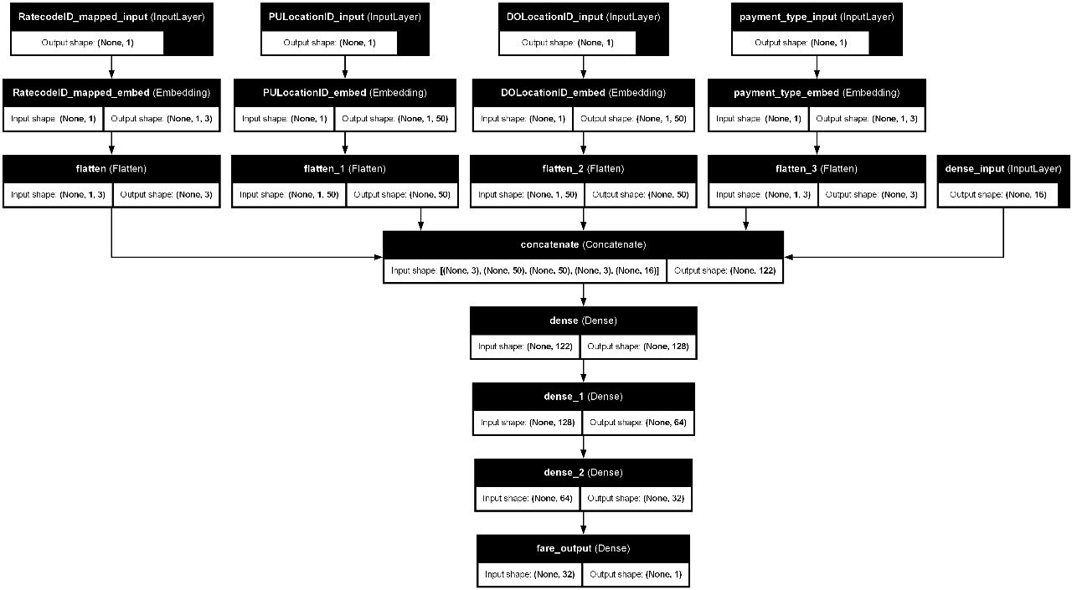
Architecture | Simple 3-layer MLP
Loss Function | MSE
Regularization | None
Metrics Tracked | MAE, MSE
Predicting Taxi Fair – FFNN Model

Slide 30
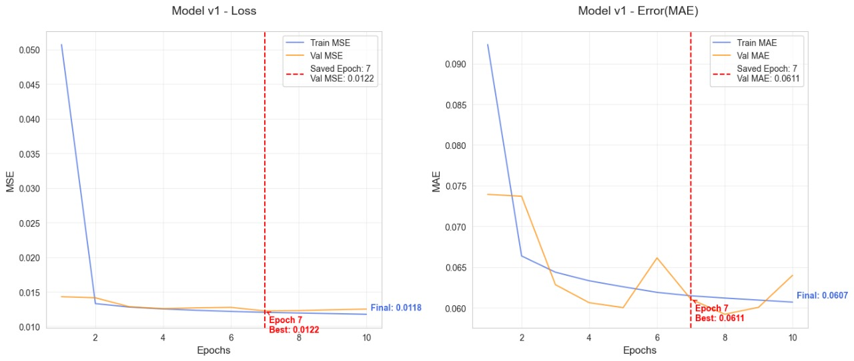
Predicting Taxi Fair – FFNN Model

Slide 31
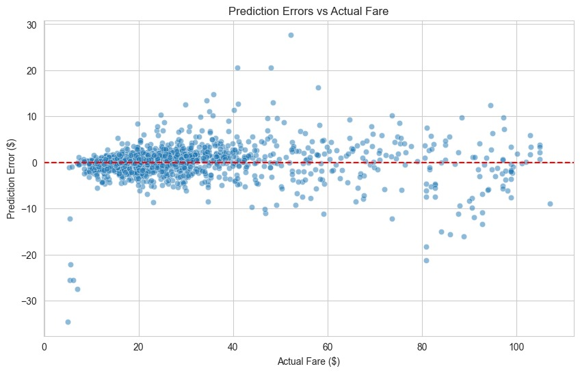
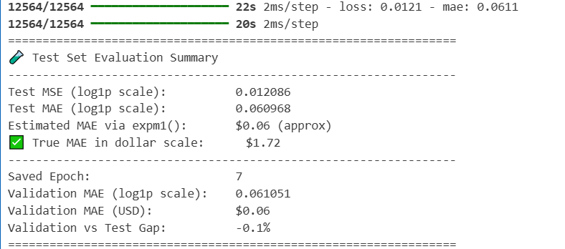
Predicting Taxi Fair – FFNN Model

Slide 32
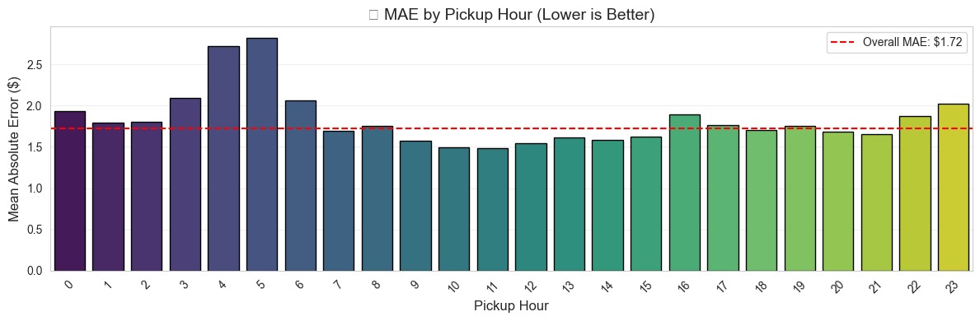

Predicting Taxi Fair – FFNN Model

Slide 33

Data Conclusion
Comprehensive Coverage: New York City is well-served by a variety of transportation modes, including buses, subways, yellow and green taxis, and high-volume for-hire vehicles (FHVs).
Staten Island Gap: Among all boroughs, Staten Island has the least transportation coverage, highlighting a potential area for infrastructure improvement.
Taxi Fare Variations: Fare structures differ significantly between taxi types:
Yellow & Green taxis: Avg. fare per mile ≈ $12
FHVs: Avg. fare per mile ≈ $7.4
Peak Hour Pricing: Fare rates tend to increase during peak hours, reflecting higher demand and possibly congestion-related delays.
These findings can support informed decision-making by state stakeholders and the Ministry of Transportation.

Slide 34
Future Direction

Slide 35

Future direction
We’re planning to taking on the bigger challenge: transportation analysis in Egypt. Our goal is to predict fares and travel times—despite the lack of detailed, structured data. With the right preprocessing and determination, we believe it’s achievable.

Slide 36
Thank You

